Slide 1


David Villers
01/19/2024

Slide 2

Outline
Executive Summary
Introduction
Methodology
Results
Conclusion
Appendix

Slide 3
Executive Summary
Summary of Methodologies
Data Collection
Data Wrangling
EDA with Visualization
EDA with SQL
Interactive Map using Folium
Interactive Dashboard using Plotly Dash
Predictive analysis using Machine Learning Techniques
Summary of all Results
EDA Results
Interactive Results using Screenshots of Map/Dashboard
Predictive Analysis Results

Slide 4
Introduction
Project background and context
SpaceX is the most successful company of the commercial space age, making space travel affordable. The company advertises Falcon 9 rocket launches on its website, with a cost of 62 million dollars; other providers cost upward of 165 million dollars each, much of the savings is because SpaceX can reuse the first stage. Therefore, if we can determine if the first stage will land, we can determine the cost of a launch. Based on public information and machine learning models, we are going to predict if SpaceX will reuse the first stage.
Questions to be answered?
How do variables such as payload mass, launch site, number of flights, and orbits affect the success of the first stage landing?
Does the rate of successful landings increase over the years?
What is the best algorithm that can be used for binary classification in this case?

Slide 5

Section 1

Slide 6
Methodology
Data collection methodology
SpaceX Rest API
Webscrape SpaceX Wikipedia page
Perform data wrangling
Filter Data
Handle missing values
Utilize One Hot Encoding to prepare data for binary classification
Perform EDA using visualization and SQL
Perform interactive EDA with Folium and Dash
Perform predictive analysis using classification models
Build and test various classification models using machine learning techniques

Slide 7
Data Collection
Data sets used we gathered from the following sources
SpaceX API → https://api.spacexdata.com/v4/rockets/
SpaceX Wikipedia →https://en.wikipedia.org/wiki/List_of_Falcon/_9/_and_Falcon_Heavy_launches

Slide 8
Data Collection – SpaceX API
Request launch data from SpaceX API
Construct a dataframe from collected data
The SpaceX API is available to the public. We can use python to make a request to gather data and construct our database from it.
Source code :Github: Data Collection API
Handle missing Payload Mass values by replacing with the calculated mean on that column
Filter dataframe to only include Falcon 9 data

Slide 9
Data Collection – Web Scraping
Request launch data from SpaceX Wikipedia Page
Parse HTML tables to collect column names (Attributes)
Using python we can perform webscraping on the SpaceX Wikipedia webpage to collect launch data.
Source code:Github: Data Collection Web Scraping
Construct a dataframe based upon the dictionary data
Construct a dictionary of the collected data

Slide 10
Data Wrangling
Our data set indicates if the booster landed successfully. The result was listed as either True or False followed by a location such as “Ocean” or “Ground Pad.” We want to condense these results simply as to True or False and assign the results to a binary class (1 for True, 0 for False).
Calculate number of launches at each site
Calculate number of and occurrences of each orbit
Calculate number and occurrence of mission outcome of the orbits
Create landing outcome label from Outcome column (New column labeled ‘class’)
Github: Data Wrangling

Slide 11
EDA with Data Visualization
To help us better understand our data, we utilize various visualization tools and in this particular section we made several charts and graphs.
Scatter Plots → Shows the relationship between variables
Bar Plots → Shows a comparison among categories
Line Plots → Shows trends in data over time
Gitgub: EDA with Visualization

Slide 12
EDA with SQL
Tasks to be performed using SQL:
Display the names of the unique launch sites in the space mission
Display 5 records where launch sites begin with the string 'CCA'
Display the total payload mass carried by boosters launched by NASA (CRS)
Display average payload mass carried by booster version F9 v1.1
List the date when the first succesful landing outcome in ground pad was acheived.
List the names of the boosters which have success in drone ship and have payload mass greater than 4000 but less than 6000
List the total number of successful and failure mission outcomes
List the names of the booster_versions which have carried the maximum payload mass.
List the records which will display the month names, failure landing_outcomes in drone ship ,booster versions, launch_site for the months in year 2015.
Rank the count of landing outcomes (such as Failure (drone ship) or Success (ground pad)) between the date 2010-06-04 and 2017-03-20, in descending order.
Github: EDA with SQL

Slide 13
Build an Interactive Map with Folium
The following objects were displayed on the interactive map:
Makers → Indicates locations of launch sites
Circles → Highlights areas around specific launch sites
Cluster Markers → Groups nearby launch sites together when zoomed out
Lines → Indicates distance between launch site and nearest rail, city, ocean
Github: Folium

Slide 14
Build a Dashboard with Plotly Dash
User interaction features:
Dropdown List → Contained option to select particular launch site or select ALL sites
Min/Max Slider → Allows user to select a range (0-10000kg) for the payload mass
Plots displayed based upon user inputs:
Pie Chart → Shows success rate of launches
Scatter Plot → Shows correlation between payload mass and launch success
Github: Dashboard

Slide 15
Predictive Analysis (Classification)
Construct dataframe and standardize the data.
Split data into training and testing sets.
The following algorithms were used:
Logistic Regression
Support Vector Machine
Decision Tree
K-Nearest Neighbors
Find the model that best fits by observing the score values.
Perform testing using the 4 models listed to the left.
Github: Predictive Analysis with Machine Learning

Slide 16
Results
Exploratory data analysis results
Interactive analytics demo in screenshots
Predictive analysis results

Slide 17

Section 2

Slide 18
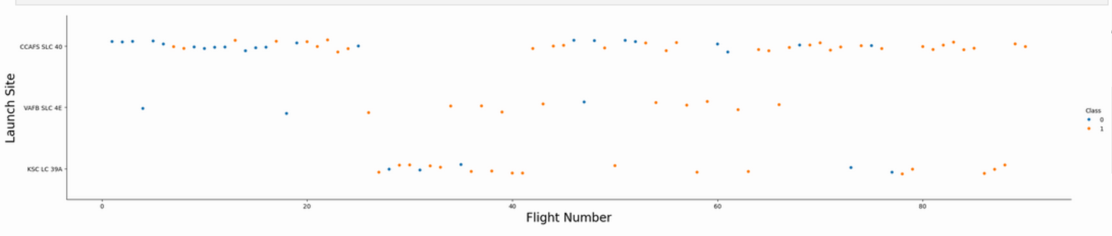
Flight Number vs. Launch Site
Takeaways:
As time goes along, the success rate of the flights increases greatly
VAFB and KSC have better success rates compared to CCAFS
CCAFS accounts for nearly 50% of all launches, with success rate being high with later launches

Slide 19
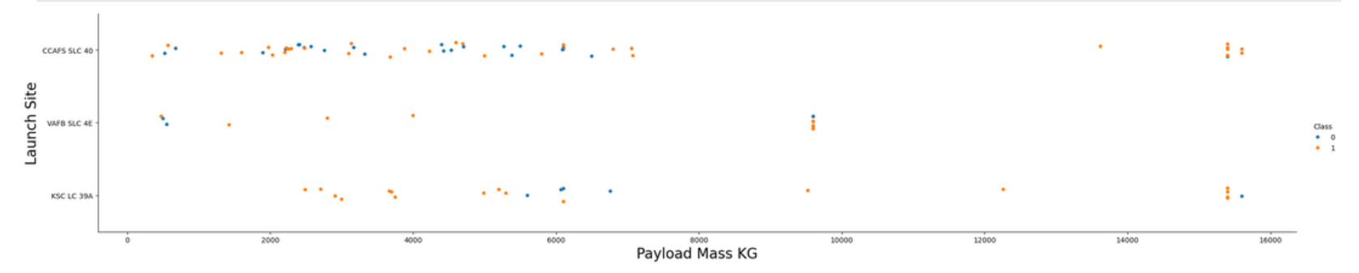
Payload vs. Launch Site
Takeaways:
The success rate increases as the mass increases among all 3 launch sites
KSC does show successful launches when the mass is under 5000 kg

Slide 20
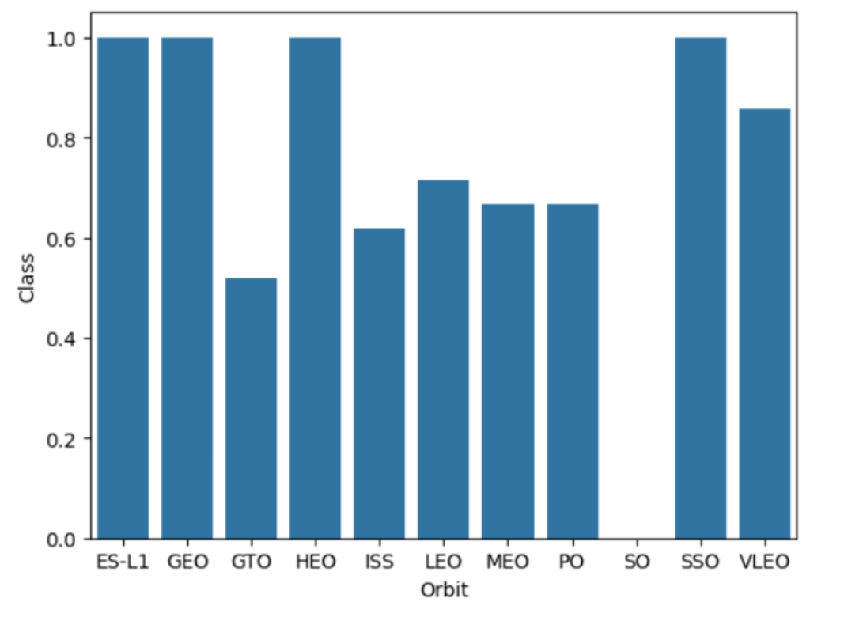
Success Rate vs. Orbit Type
Takeaways:
Launches in orbits ES-L1, GEO, HEO, and SSO had a 100% success rate
Launches into the SO orbit have yet to succeed
Launches into the ISS, LEO, MEO, PO orbits yield roughly a 65% success rate

Slide 21
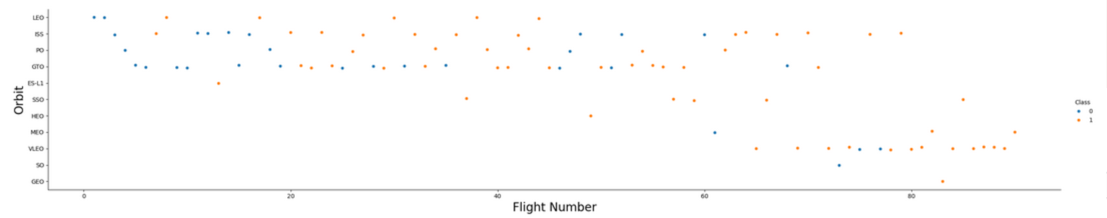
Flight Number vs. Orbit Type
Takeaways:
In general, success rate has increased over time in each orbit
The orbit VLEO has been used more frequently as of late and the success rate indicates this orbit will allow for a successful launch

Slide 22
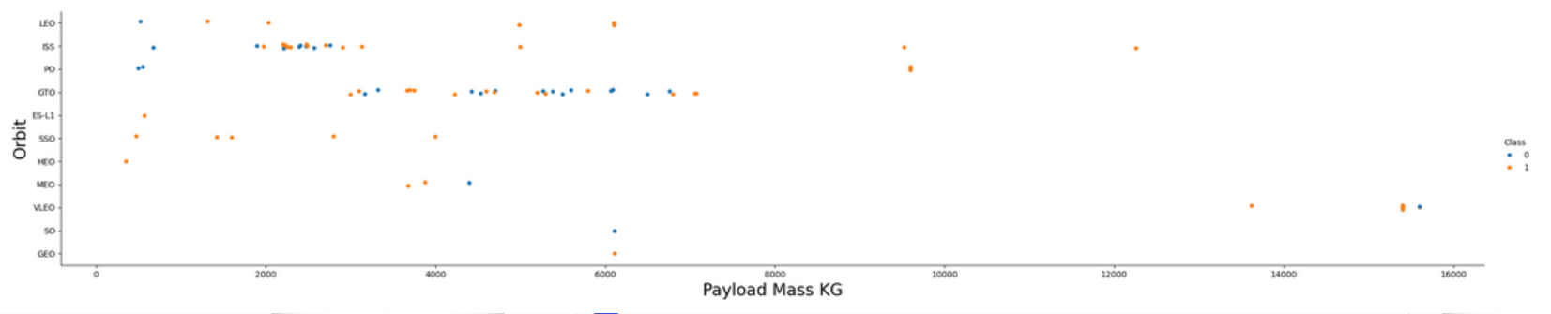
Payload vs. Orbit Type
Takeaways:
For GTO we cannot gather much insight since there are a 50/50 mix of successful landings and unsuccessful landings
PO, LEO, ISS do indicate the success rate increases as the payload mass increases

Slide 23
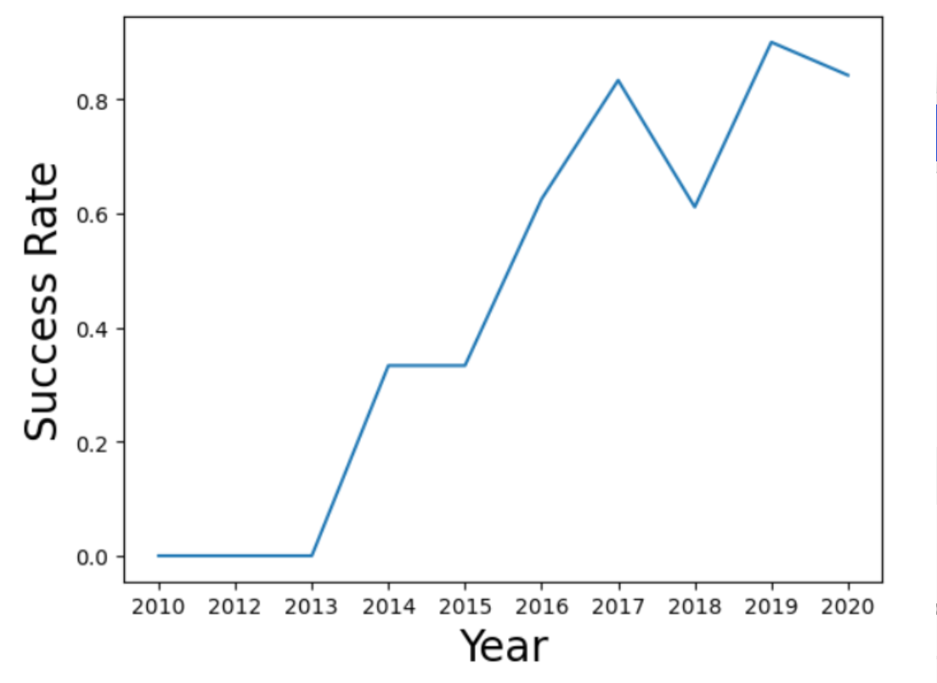
Launch Success Yearly Trend
Takeaways:
Since the year 2013, the success rate has increased over time.

Slide 24
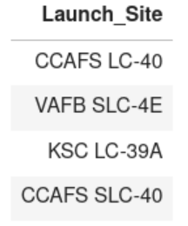
All Launch Site Names
Explanation:
Performed SQL query to display the names of the Launch Sites

Slide 25
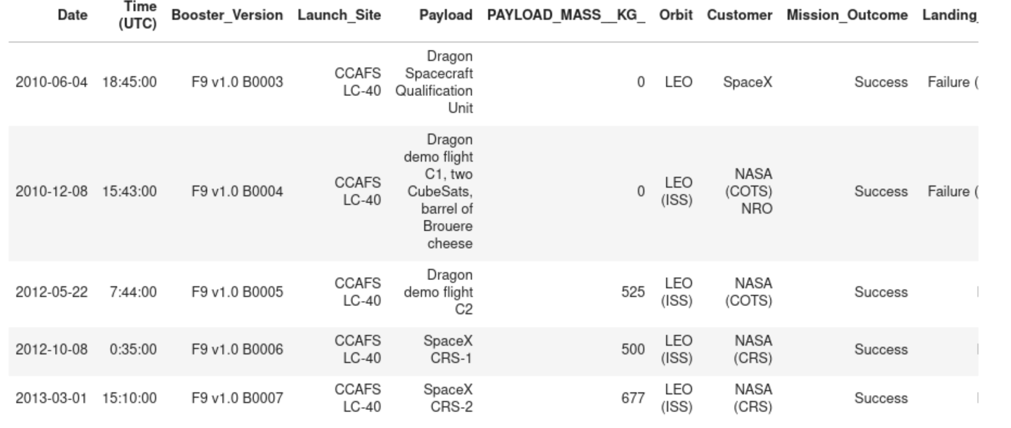
Launch Site Names Begin with 'CCA'
Explanation:
Performed SQL query to display the names of the Launch Sites that begin with ‘CCA’ and displaying the first 5 results

Slide 26
Total Payload Mass
Calculate the total payload carried by boosters from NASA
Present your query result with a short explanation here

Slide 27
Average Payload Mass by F9 v1.1
Calculate the average payload mass carried by booster version F9 v1.1
Present your query result with a short explanation here

Slide 28
First Successful Ground Landing Date
Find the dates of the first successful landing outcome on ground pad
Present your query result with a short explanation here

Slide 29
Successful Drone Ship Landing with Payload between 4000 and 6000
List the names of boosters which have successfully landed on drone ship and had payload mass greater than 4000 but less than 6000
Present your query result with a short explanation here

Slide 30
Total Number of Successful and Failure Mission Outcomes
Calculate the total number of successful and failure mission outcomes
Present your query result with a short explanation here

Slide 31
Boosters Carried Maximum Payload
List the names of the booster which have carried the maximum payload mass
Present your query result with a short explanation here

Slide 32
2015 Launch Records
List the failed landing_outcomes in drone ship, their booster versions, and launch site names for in year 2015
Present your query result with a short explanation here

Slide 33
Rank Landing Outcomes Between 2010-06-04 and 2017-03-20
Rank the count of landing outcomes (such as Failure (drone ship) or Success (ground pad)) between the date 2010-06-04 and 2017-03-20, in descending order
Present your query result with a short explanation here

Slide 34

Section 3

Slide 35
<Folium Map Screenshot 1>
Replace <Folium map screenshot 1> title with an appropriate title
Explore the generated folium map and make a proper screenshot to include all launch sites’ location markers on a global map
Explain the important elements and findings on the screenshot

Slide 36
<Folium Map Screenshot 2>
Replace <Folium map screenshot 2> title with an appropriate title
Explore the folium map and make a proper screenshot to show the color-labeled launch outcomes on the map
Explain the important elements and findings on the screenshot

Slide 37
<Folium Map Screenshot 3>
Replace <Folium map screenshot 3> title with an appropriate title
Explore the generated folium map and show the screenshot of a selected launch site to its proximities such as railway, highway, coastline, with distance calculated and displayed
Explain the important elements and findings on the screenshot

Slide 38

Section 4

Slide 39
<Dashboard Screenshot 1>
Replace <Dashboard screenshot 1> title with an appropriate title
Show the screenshot of launch success count for all sites, in a piechart
Explain the important elements and findings on the screenshot

Slide 40
<Dashboard Screenshot 2>
Replace <Dashboard screenshot 2> title with an appropriate title
Show the screenshot of the piechart for the launch site with highest launch success ratio
Explain the important elements and findings on the screenshot

Slide 41
<Dashboard Screenshot 3>
Replace <Dashboard screenshot 3> title with an appropriate title
Show screenshots of Payload vs. Launch Outcome scatter plot for all sites, with different payload selected in the range slider
Explain the important elements and findings on the screenshot, such as which payload range or booster version have the largest success rate, etc.

Slide 42

Section 5

Slide 43
Classification Accuracy
Visualize the built model accuracy for all built classification models, in a bar chart
Find which model has the highest classification accuracy

Slide 44
Confusion Matrix
Show the confusion matrix of the best performing model with an explanation

Slide 45
Conclusions
Point 1
Point 2
Point 3
Point 4
…

Slide 46
Appendix
Include any relevant assets like Python code snippets, SQL queries, charts, Notebook outputs, or data sets that you may have created during this project

Slide 47


